Slide 1


CARBON FOOTPRINTS PREDICTION
Varuchi Maurya
Dr.Akhilesh Das Gupta institute of professional Studies
Student ID : STUSTU687e3cb69abf61753103542
AICTE Internship ID: INTERNSHIP_17513641056863b20937d78

Slide 2

Learning Objectives
To analyze the impact of operational factors on industrial carbon emissions.
To preprocess and model industry datasets for prediction.
To apply Machine Learning for accurate carbon footprint estimation.
To visualize the correlation between features and emissions.
To support sustainable energy and efficiency initiatives.
GOAL
Source :
www.freepik.com/

Slide 3
Tools and Technology used
Programming Language : Python
Libraries : Pandas, NumPy, Scikit_Learn, matplotlib, Seaborn
IDE : Jupyter Notebook, VS Code
GitHub for version control and collaboration

Slide 4
Methodology
Problem statement.
Collecting the Dataset.
Data Cleaning and Preprocessing.
Training the Model (Linear Regression for prediction)
Evaluations (MSE, R² score)
Visualizations
Predictions using user input
Deployment

Slide 5
Problem Statement:
This project aims to develop an AI/ML-based predictive model that estimates the carbon footprint (kg CO₂) of an industry using operational features like energy consumption, fuel type, production capacity, and efficiency levels.
Such a model will help organizations quantify, forecast, and minimize emissions, thereby supporting the goals of sustainable energy and efficiency.

Slide 6
Solution:
To address the problem of monitoring and reducing industrial carbon emissions, an AI/ML-based predictive framework is developed.
Data Preprocessing & Cleaning
Removed duplicates and missing values.
Encoded categorical variables (Fuel Type) using mapping.
Feature Engineering
Derived correlation values to measure the impact of each feature.
Created mappings for Fuel Type to reflect emission intensity.
3. Model Development
Trained and tested the model using an 80-20 split.
Implemented Linear Regression for prediction.
Evaluated using MSE and R² Score to ensure accuracy.

Slide 7
4. Visualization
Correlation Heatmap to show relationships between features and emissions.
Bar charts to highlight feature impact on carbon emissions.
5. Outcome
A predictive model that estimates Carbon Footprint (kg CO₂) for industries.
Clear identification of major contributing factors like electricity usage, production volume, fuel type, efficiency rating.
Recommendations for industries to optimize fuel usage and increase efficiency for sustainability.
GitHub Link : https://github.com/varuchi09/Week-1

Slide 8
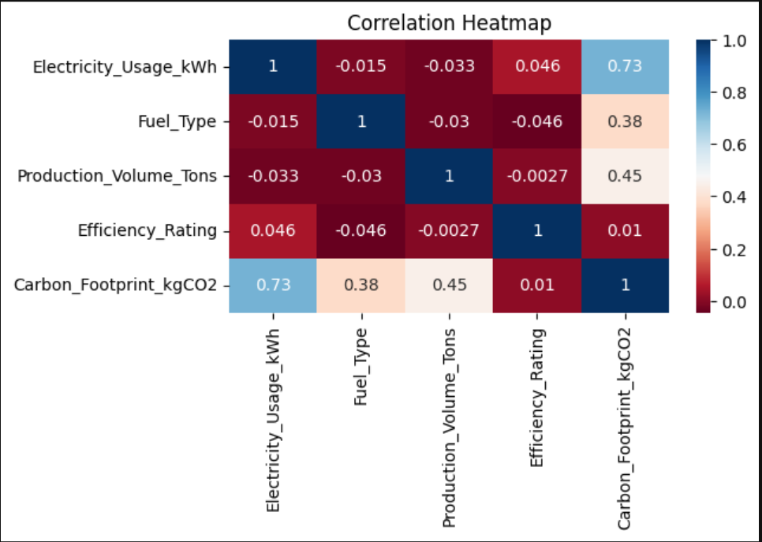

Screenshot of Output:
Accuracy Of the model

Slide 9
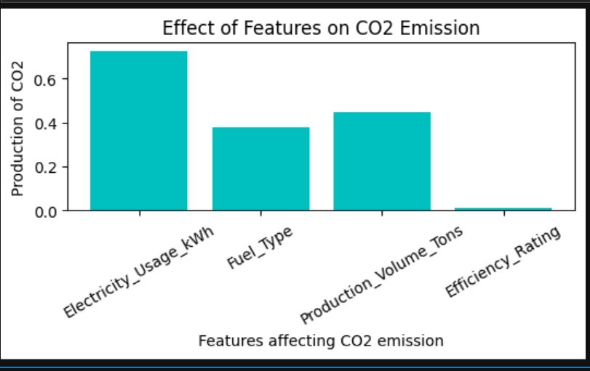
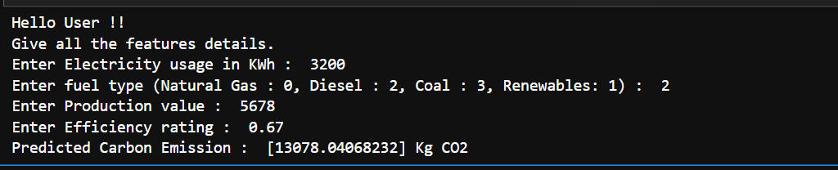

Slide 10
Conclusion:
Developed a machine learning model for predicting industrial carbon emissions.
Identified Electricity Usage and Production Volume as strongest positive contributors.
Efficiency Rating showed negative correlation → higher efficiency reduces emissions.
Provides industries with insights to move towards sustainable energy and efficiency.
Future Scope:
Integration with real time data.
Extend the model to not only predict emissions but also suggest actionable strategies (e.g., switch fuel type, improve efficiency).

